Slide 1
Mental health Rx before and after COVID A Synthetic Control Analysis
Alanoud Alturki

Slide 2
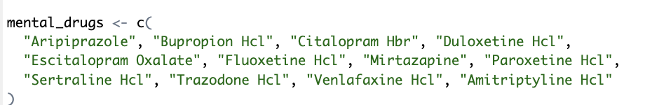
Mental Health Prescriptions Pre- And Post-covid
Research Question
Did the COVID-19 pandemic lead to significant changes in mental health prescription rates across U.S. states?

Slide 3
Synthetic Control Method
Treated Unit: A state that expanded mental health access (telehealth mandates in 2020)
Intervention Date: March 2020 (start of COVID-19)
Outcome Variable: Mental health prescriptions per 1,000 beneficiaries
Control Units: States without early or aggressive expansion
Dataset : CMS Medicare Part D Public Use File (2017–2022)

Slide 4
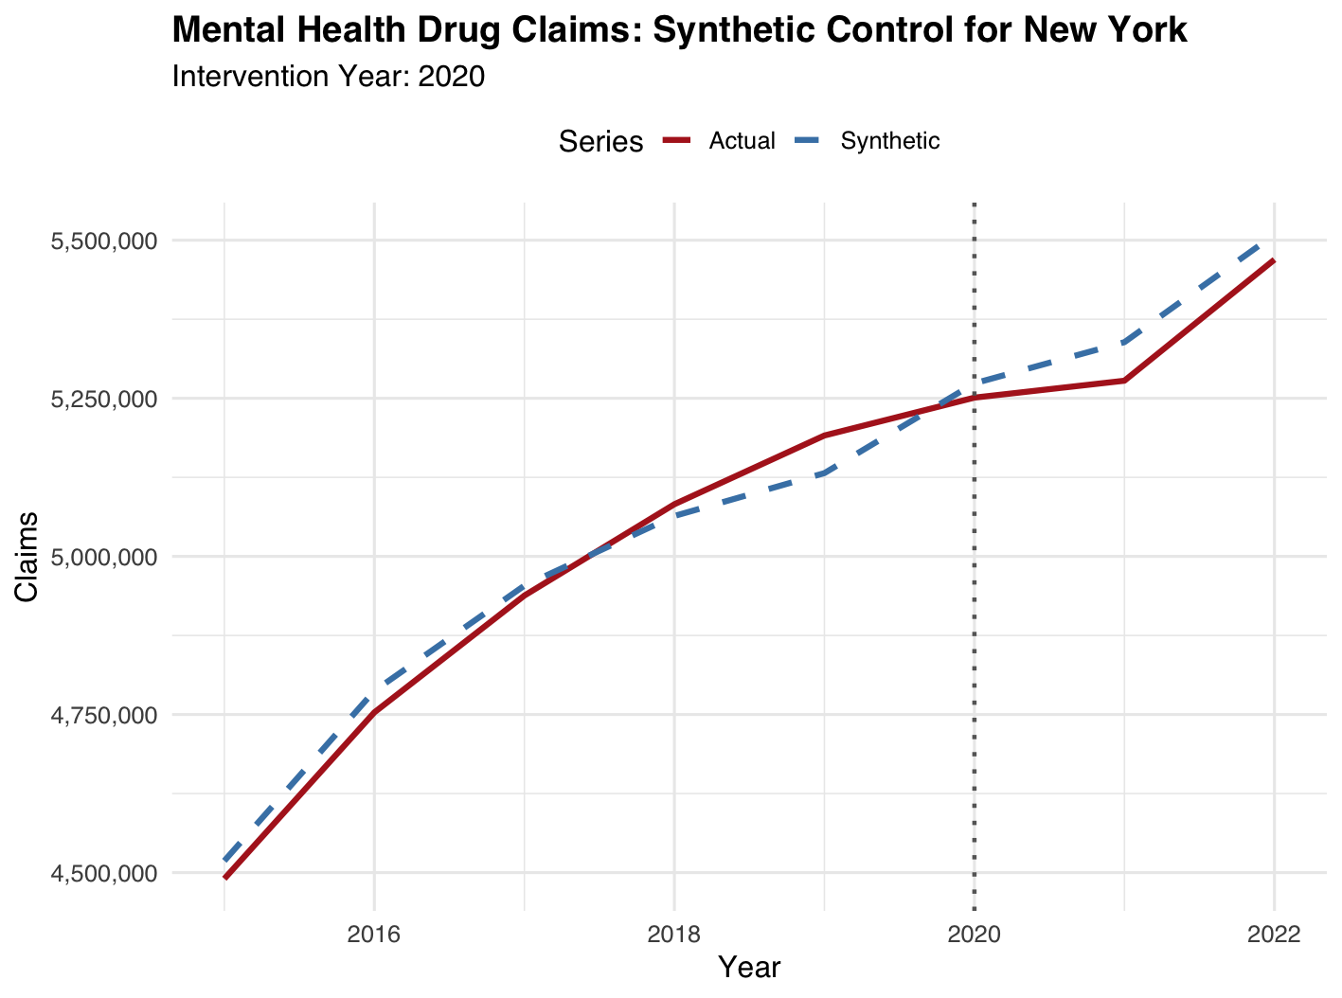
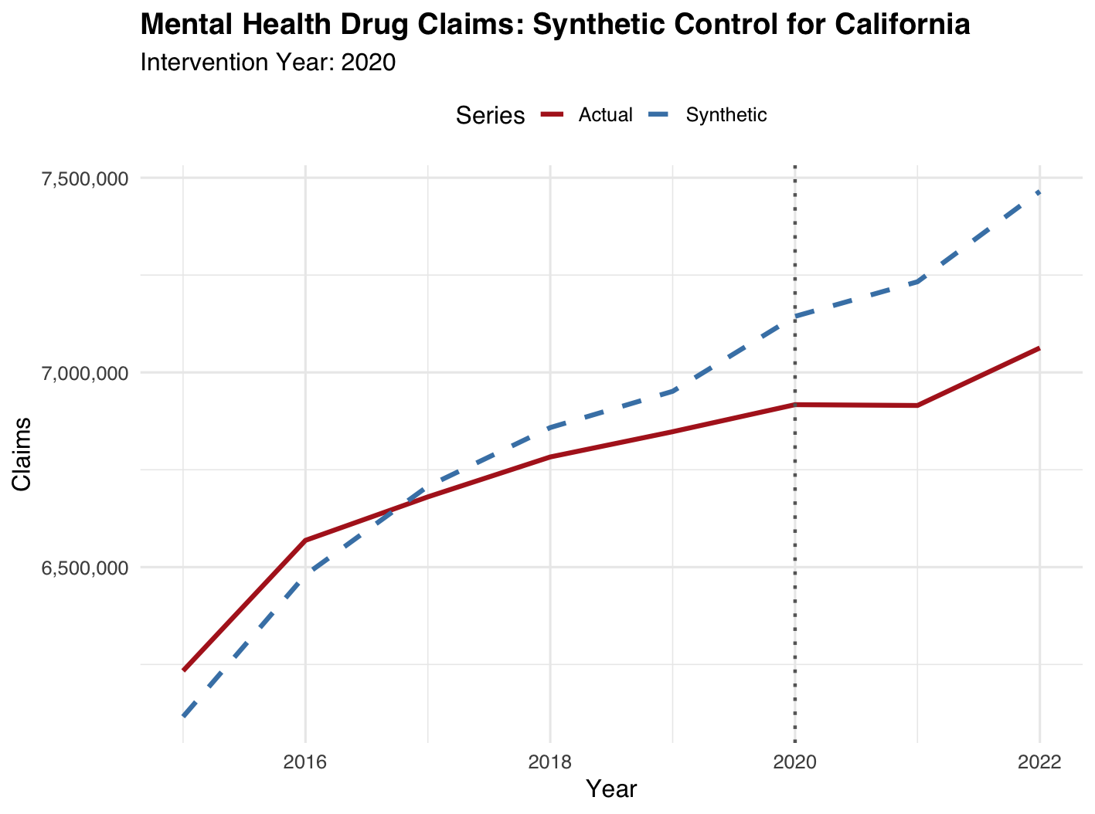
Synthetic Control Method

